Slide 1
XGBoost for Regression

Slide 2
What is
XGBoost for Regression
XG BOOST is an optimized and scalable implementation of the gradient boosting framework designed for supervised learning tasks such as regression and classification. In regression, XGBoost aims to predict continuous numeric values by minimizing loss functions (e.g., RMSE or MSE) while incorporating regularisation to prevent overfitting.

Slide 3
Formula and syntax
Obj=∑i=1n​L(yi​,y^​i​)+Ω(ft​)
import xgboost as xgb
model = xgb.XGBRegressor(objective='reg:squarederror',
n_estimators=100, random_state=42)
model.fit(X_train, y_train)

Slide 4
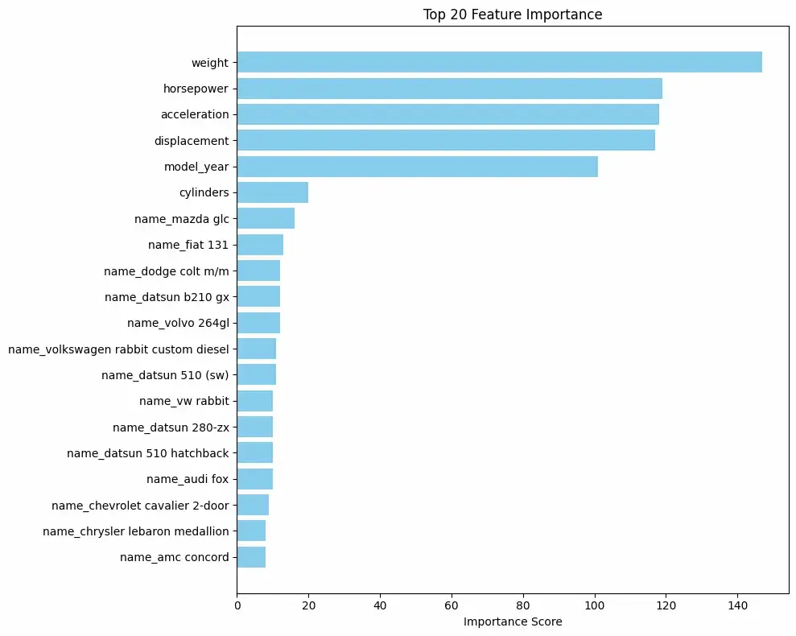

Slide 5
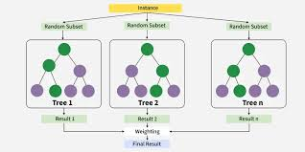

Slide 6
